Slide 1
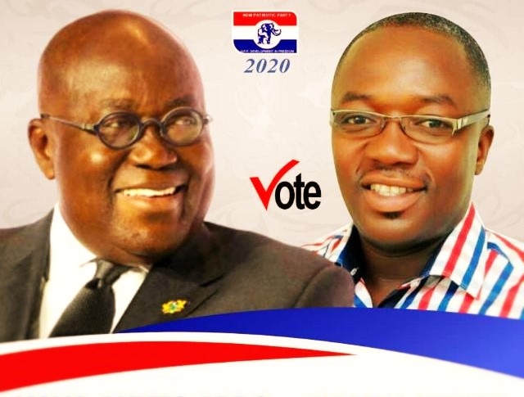
NEW PATRIOTIC PARTY
DEVELOPMENT IN FREEDOM
LEADERSHIP OF SERVICE:
PROTECTING OUR PROGRESS
Transforming SEKYERE AFRAM PLAINS for all
FOUR MORE TO DO MORE FOR YOU
THE BATTLE IS STILL THE LORD’S
2020 MANIFESTO
SEKYERE AFRAM PLAINS CONSTITUENCY

Slide 2
THE PARTY’ S VISION
“The party’s vision is to liberate the energies of the people for the growth of a property owning democracy in this land,
with right to life, freedom and justice, as the principles to which the Government and laws of the land should be dedicated in order specifically to
enrich life, property and liberty of each and every citizen”
Dr. J.B. Danquah
1
NEW PATRIOTIC PARTY (NPP) • 2020 MANIFESTO

Slide 4
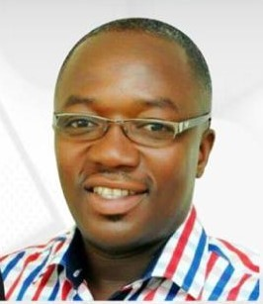
CONSTITUENCY VISION
THE NPP GOVERNMENT LED BY H.E NANA ADDO DANQUAH AKUFFO ADDO HAD PROVED TO THE PEOPLE OF GHANA OF WHAT WE CALLED EXCELLENT LEADERSHIP. THEREFORE WE AT SEKYERE AFRAM PLAINS AS A CONSTITUENCY WILL ENSURE THAT THE PARTY’S VISION AND AIM WILL COME TO REALITY AND THAT IS WHAT WE HAVE STARTED. WE THEREFORE PLEAD WITH EVERY HOUSEHOLD TO COME OUT IN THEIR NUMERS COME DECEMBER 7TH TO VOTE MASIVELY TO CONSOLIDATE OUR GAINS FOR THE BETTERMENT OF OUR CHILDREN AND GRANDCHILDREN.
WE BELIEVE THAT WITH ONE GOAL AND ONE PURPOSE WE SHALL BRING SEKYERE AFRAM PLAINS TO ITS GLORY .
GOD BLESS SEKYERE AFRAM PLAINS, GOD BLESS NPP
HON. JOSEPH OWUSU
(Odenkyem)
3
NEW PATRIOTIC PARTY (NPP) • 2020 MANIFESTO

Slide 5
Problems
Inherited
NEW PATRIOTIC PARTY (NPP) • 2020 MANIFESTO
4

Slide 6
Dumsor
Poor Infrastructure
PROBLEMS INHERITTED
1
2
3
Youth Unemployment
4
Poor Living Standards
5
Inability to Pay fees
6
Conflict between
Crop farmers and Cattle Herders
7
And Many More
NEW PATRIOTIC PARTY (NPP) • 2020 MANIFESTO

Slide 7
WHAT WE HAVE
DONE
………Leaving No One Behind
....Leaving No One Behind
NEW PATRIOTIC PARTY (NPP) • 2020 MANIFESTO
6

Slide 8
Infrastructure
PROJECT TITLE | WHO BENEFITD | NO OF BENEFICIARIES | COMMUNITIES
1. CONDTRUCTION OF DCE QUARTERS | DCE | CONSTITUENCY AT LARGE | DROBONSO
2. CONSTRUCTION OF 2 BED ROOM NURSES QUATERS | NURSES AND DOCTORS | CONSTITUENCAT LARGE | DROBONSO
3. CONSTRUCTION OF 2 BED ROOM NURSES QUATERS | NURSES AND DOCTERS | FUMSUA COMMUNITY | FUMSUA
4. CONSTRUTION OF 3 UNIT CLASSROOM BLOCK (on –going) | COMMUNITY |  | NYAME BEKYERE
5. CONSTRUCTION OF 6 UNIT CLASSROOM BLOCK (on-going) | COMMUNITY | R.C SCHOOL | DROBONSO
6. RECONSTRUCTION OF POLICE POST | COMMUNITY |  | ANYINOFI
7. CONSTRUCTION OF 3 UNIT CLASSROOM PAVILION | COMMUNITY | ISLAMIC PRIM. | DROBONSO
8. CONSTRUCTIN OF 3 UNIT PAVILION (on-going) | COMMUNITY |  | MEMPEKASA
9. CONSTRUCTION OF 3 UNIT CLASS ROOM | COMMUNITY |  | BOSOMFUO
10. 3 UNIT PAVILION (on-going) | COMMUNITY |  | WENAMDA
11. CONSTRUCTION OF 3UNIT PAVILION | COMMUNITY |  | BABADUASO
12. COMMUNITY SOLAR SYSTEM IMPLEMENTATION | COMMUNITY |  | FUNSUA NYAMEAMA NO 2
CONSTRUCTION OF 3 UNIT CLASSROOM | COMMUNITY |  | KUBU
POLICE POST ABD OFFICERS QUARTERS AND ETC. | COMMUNITY |  | ABOTANTIRI
NEW PATRIOTIC PARTY (NPP) • 2020 MANIFESTO
10

Slide 9
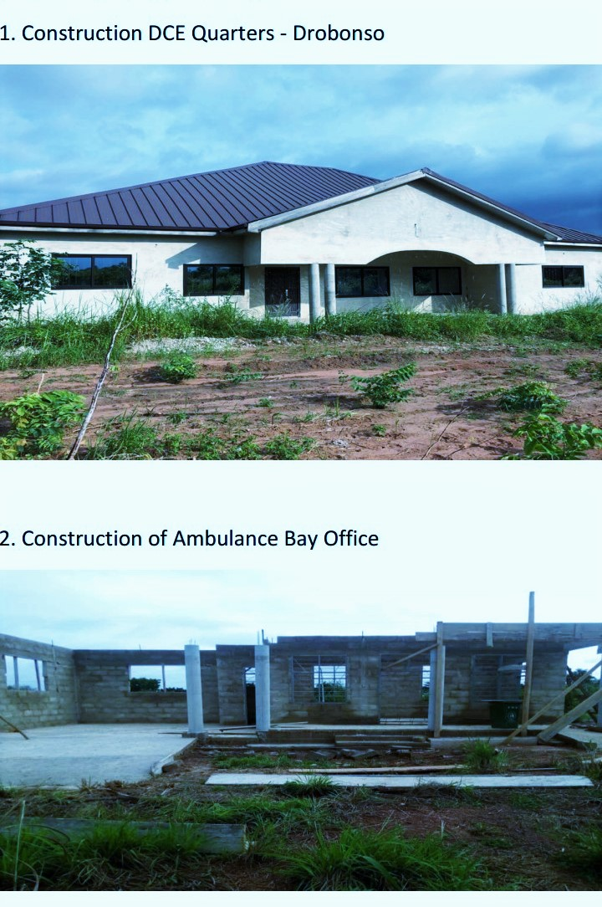
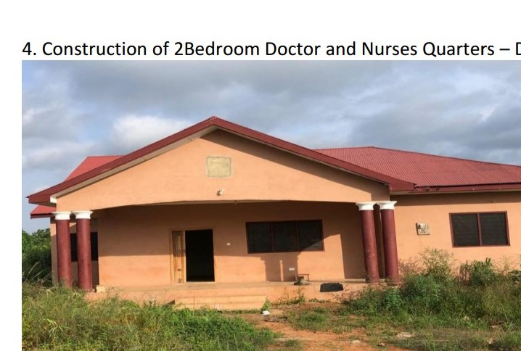
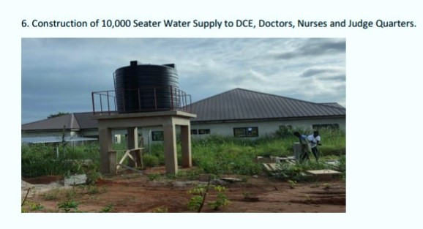
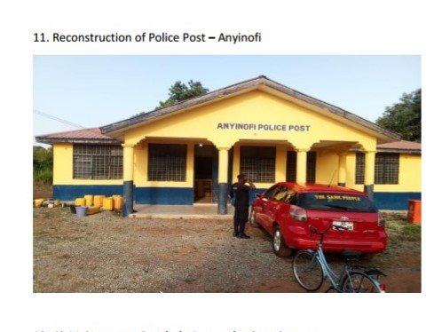
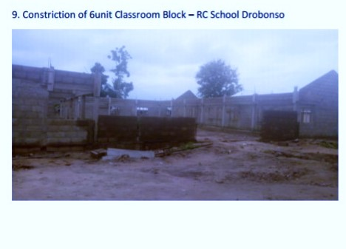
CONTINUATION OF D.C.E BANGALOW
(PICTURES FOR INFRASTRUCTURE HERE)
RE-HABILITATION OF ANYINOFI POLICE POST
NEW PATRIOTIC PARTY (NPP) • 2020 MANIFESTO
14

Slide 10
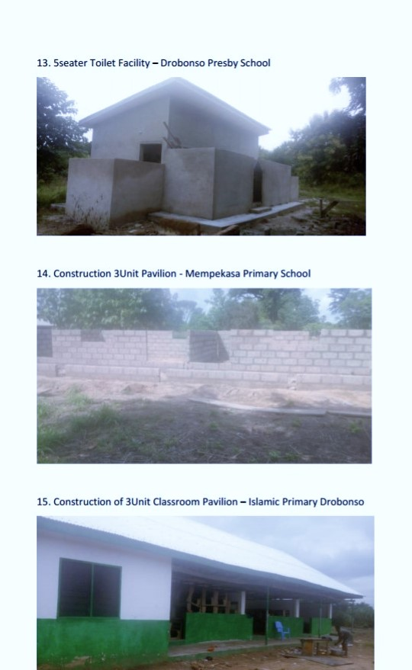
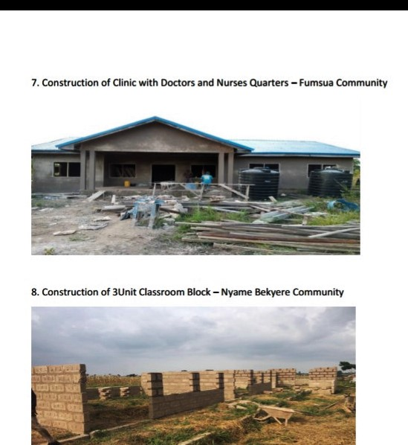
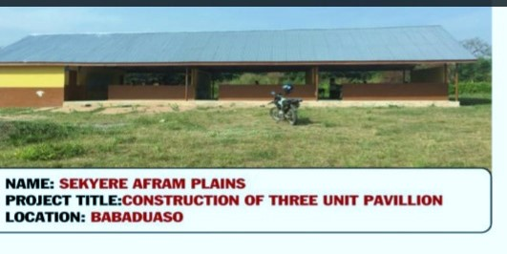
(PICTURES FOR INFRASTRUCTURE HERE)
NEW PATRIOTIC PARTY (NPP) • 2020 MANIFESTO
16

Slide 11
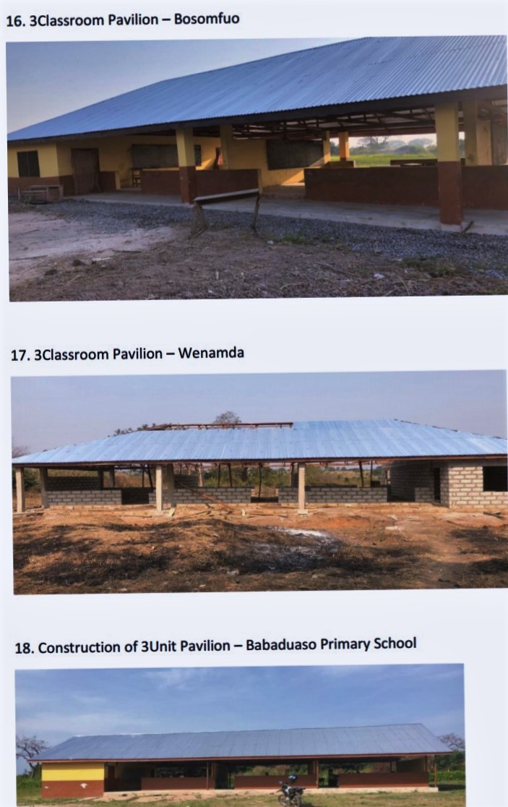
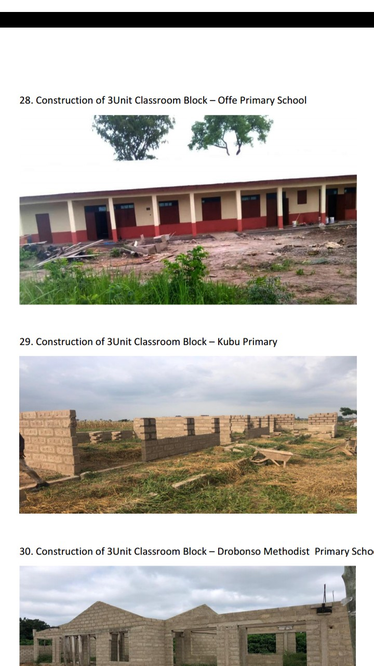
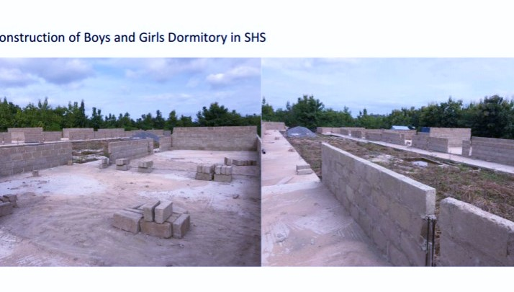
(PICTURES FOR INFRASTRUCTURE HERE)
15
NEW PATRIOTIC PARTY (NPP) • 2020 MANIFESTO

Slide 12
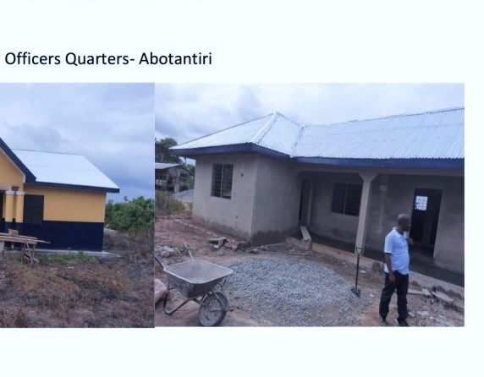
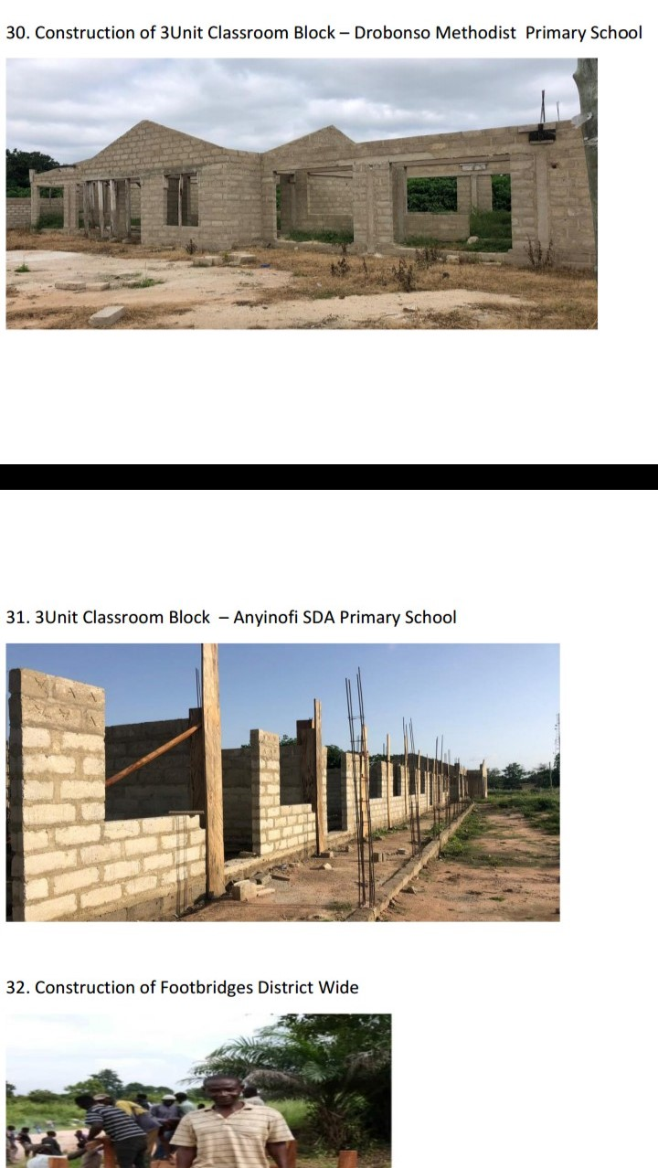
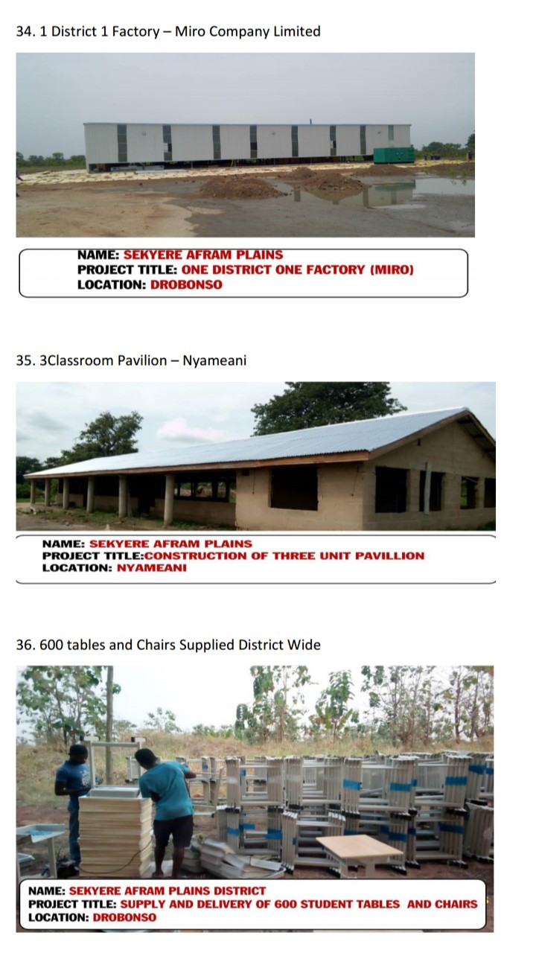
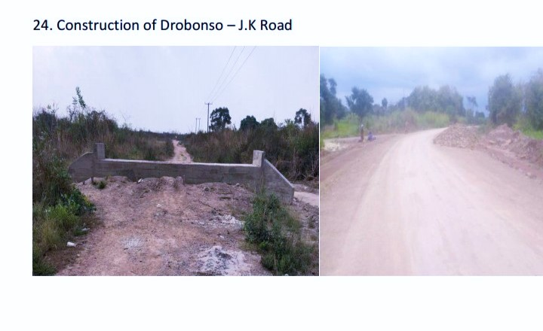

Slide 13
Energy Rural Electrification
ACTIVITIES | WHO BENEFITS | NO. OF BENEFICIARIES /QUANTITY | COMMUNITIES
EXTENSION OF ELECTRICITY | COMMUNITY | COMMUNITY | ANYINOFI DAGOMBA
INSTALLATION OF STREET LIGHTS AND ENERGY SAVING BULBS TO HOUSE HOLDS | COMMUNITY | ALL COMMUNITIES | CONST. WIDE
FREE ELECTRICITY FOR ALL HOUSEHOLDS | COMMUNITY | HOUSEHOLDS | CONSTITUENCY WIDE
NEW PATRIOTIC PARTY (NPP) • 2020 MANIFESTO
8

Slide 14
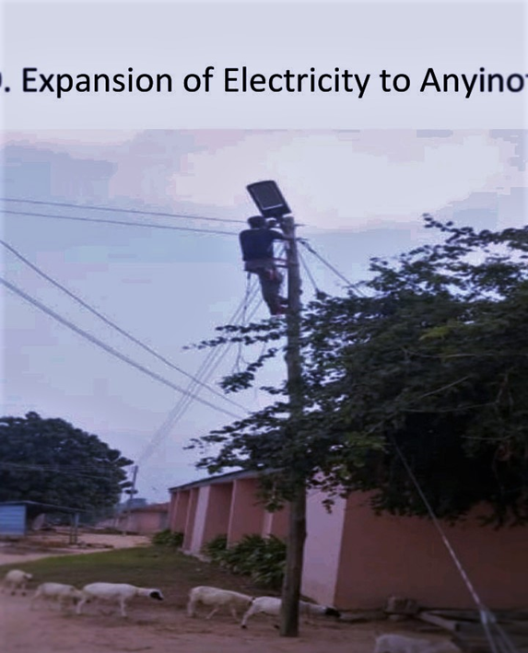
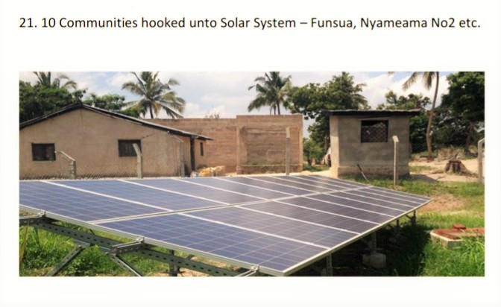
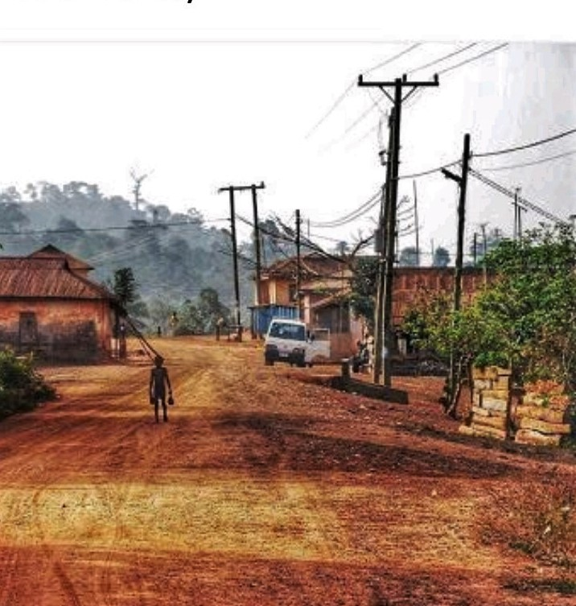
Community solar system
Community power extension
Anyinofi electricity project
9
NEW PATRIOTIC PARTY (NPP) • 2020 MANIFESTO

Slide 15
Youth and Jobs
Activities |  | WHO BENEFITS | NO. of Beneficiaries | Communities
 |  |  | /Quantity
YEA Employed Youth under ¹ Community Policing and Sanitation |  | youths | 72 | Const. wide
₂ NABCO Recruited Unemployed Graduates |  | youths | 216 | Const. wide
Forestry Commission employed ³ unemployed Youth under Youth in Afforestation Program
4
⁶
NEW PATRIOTIC PARTY (NPP) • 2020 MANIFESTO

Slide 16
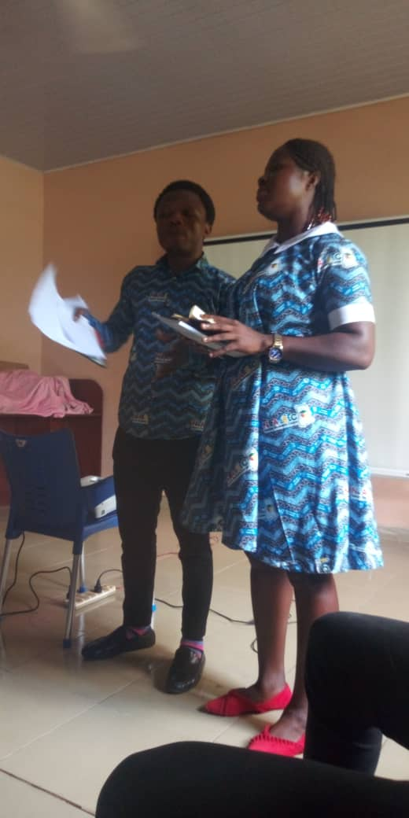
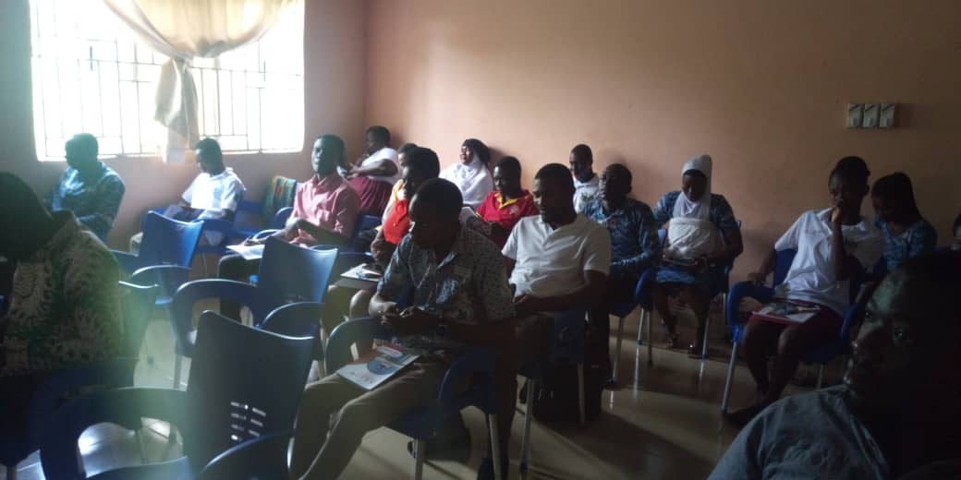
NEW PATRIOTIC PARTY (NPP) • 2020 MANIFESTO

Slide 17
Agriculture And Development
ACTIVITIES |  | WHO BENEFITS | NO. BENEFICIARIES /QUANTITY | COMMUNITIES
1 | Subsidies for Farm inputs for farmers | Farmers | 10,000 | Constituency Wide
2 | Beneficiaries of Planting for Food and Jobs | Farmers | 22,500 | Community Wide
3 | (nursery and seedling for framers | Farmers | 20,000 | Community Wide
4 | Supply of farm inputs to farmers | Farmers | 25,000 | Community Wide
5 | One pick up and 14 motor bikes for agriculture extension services | Agric Officers | 14 | Constituency Wide
NEW PATRIOTIC PARTY (NPP) • 2020 MANIFESTO

Slide 18
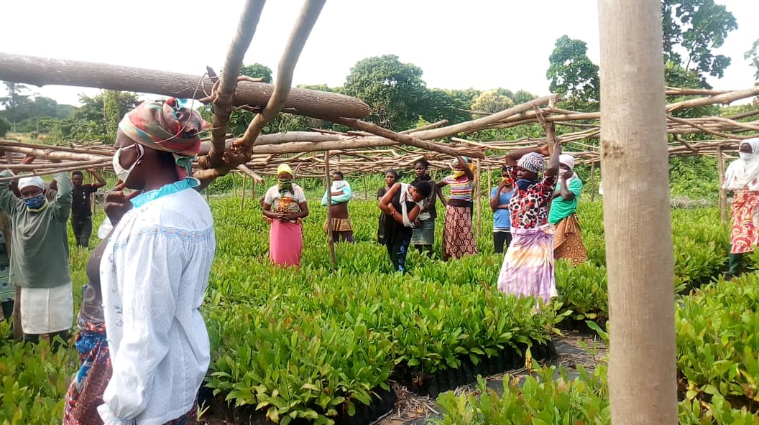
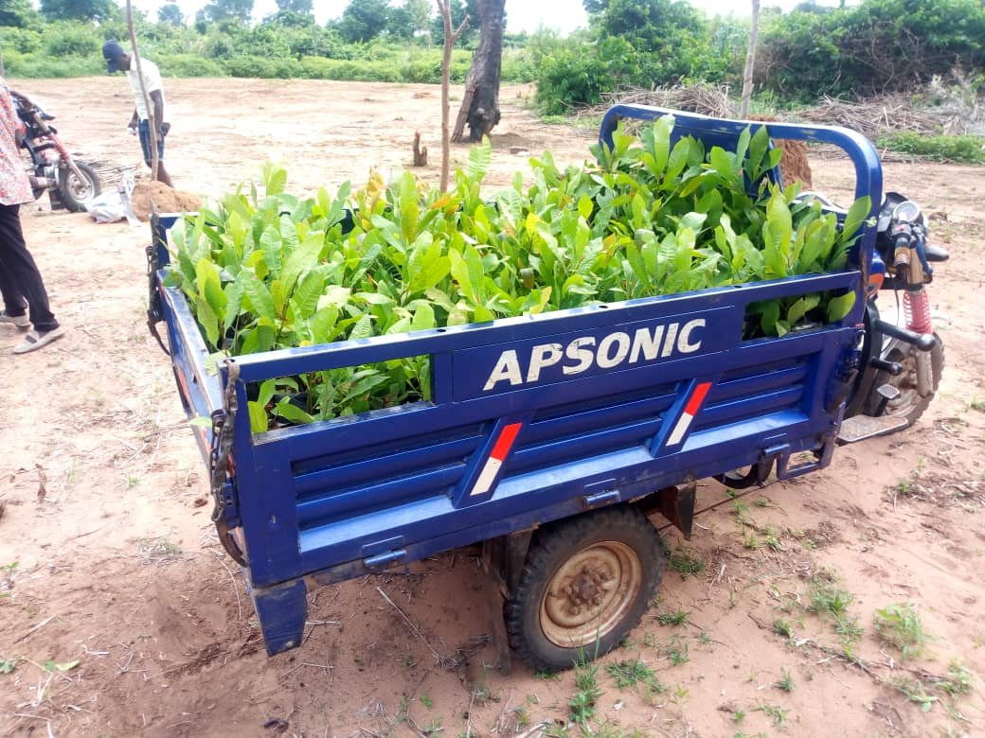
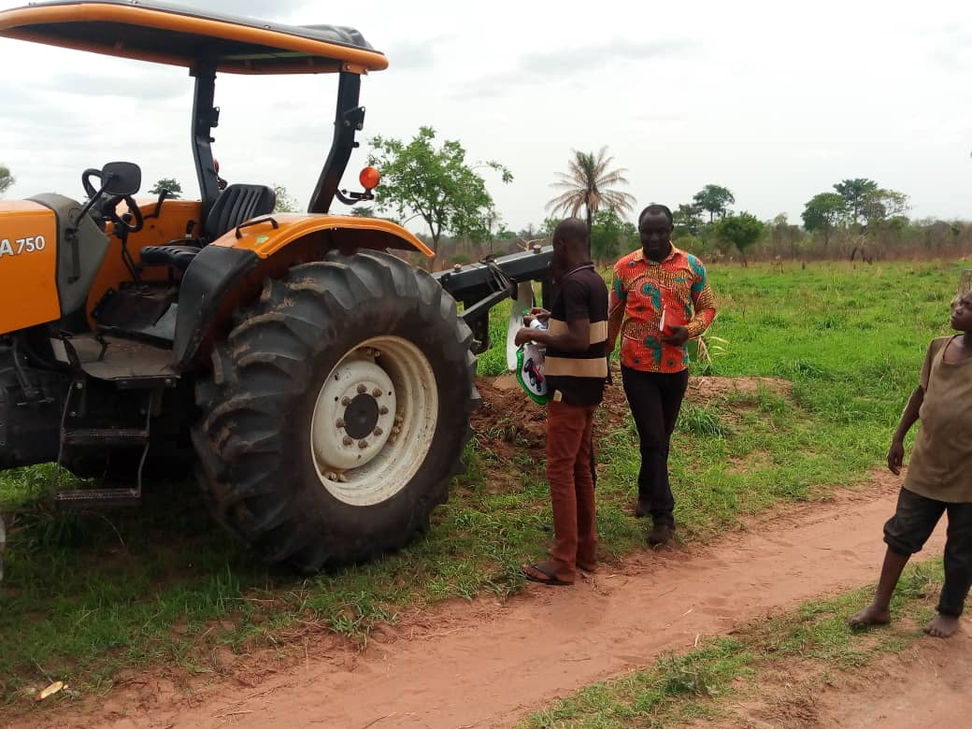
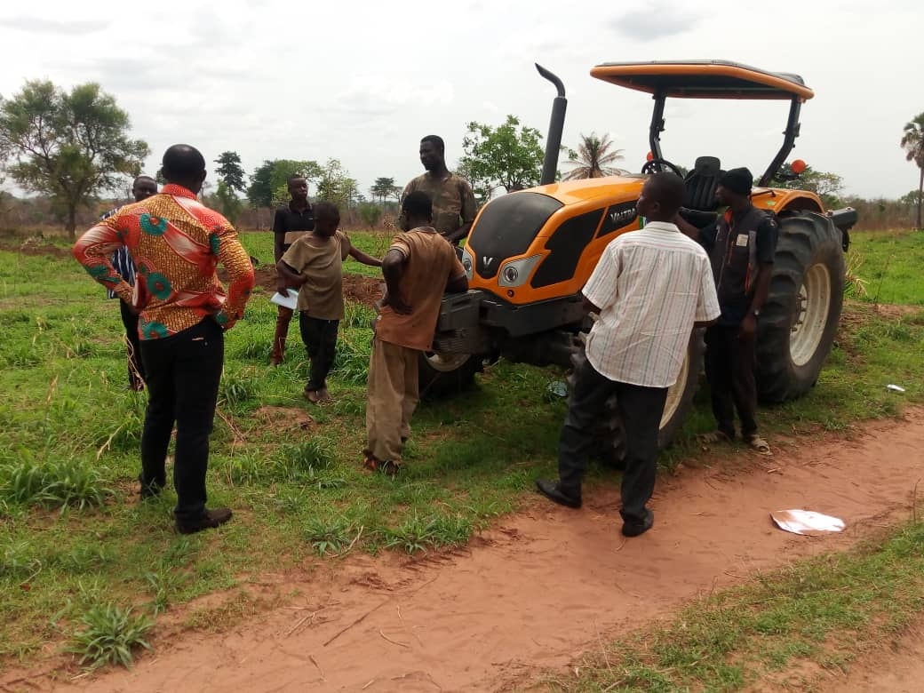
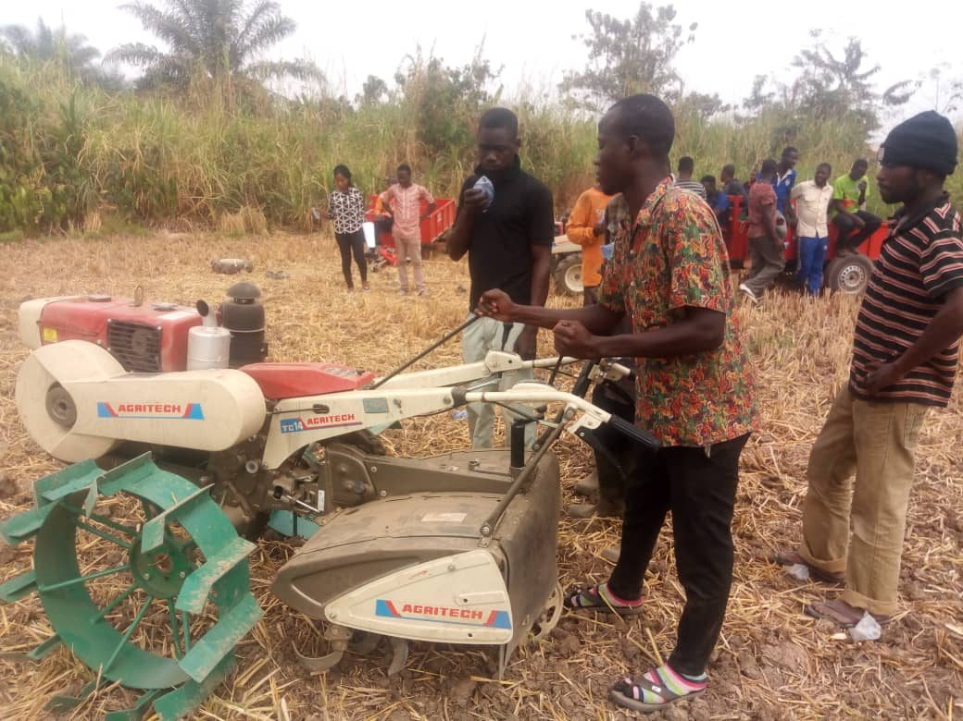
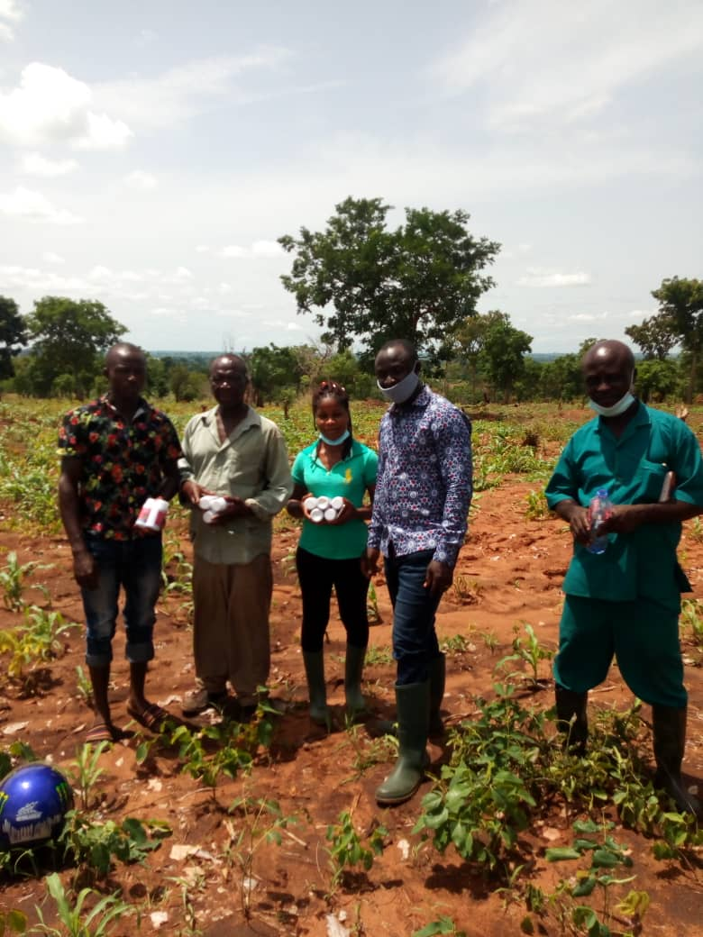
(PICTURES FOR AGRICULTURE AND RURAL DEVELOPMENT HERE)
NEW PATRIOTIC PARTY (NPP) • 2020 MANIFESTO
20

Slide 19
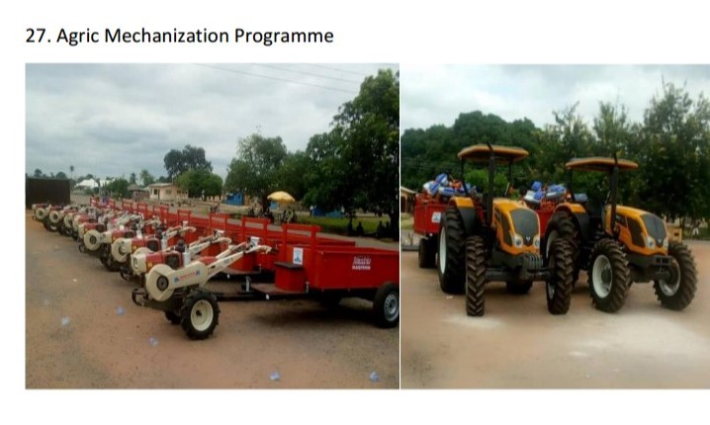
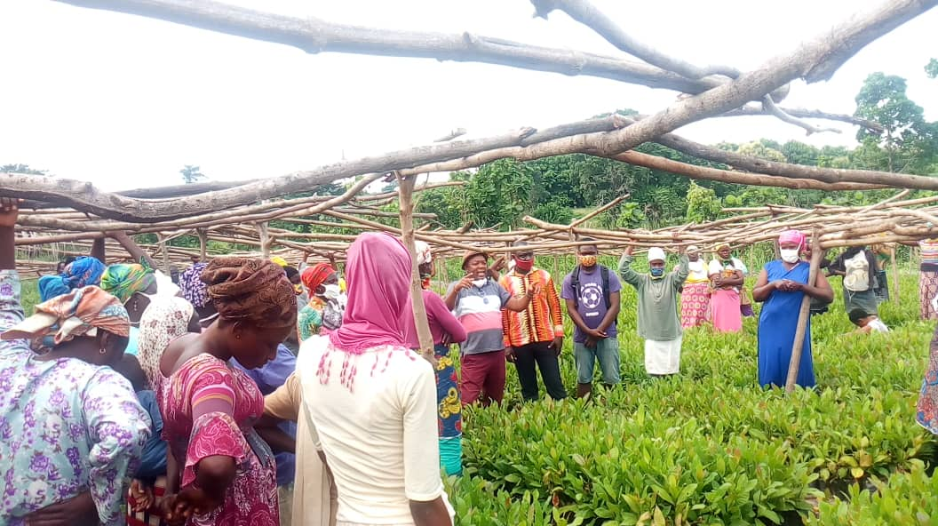
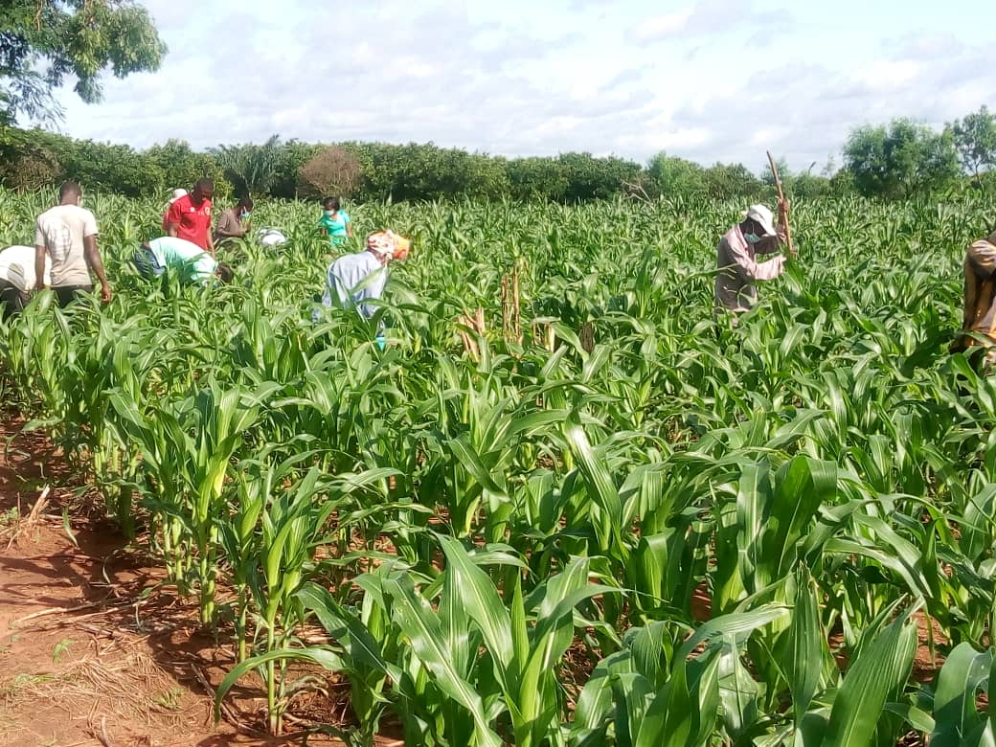
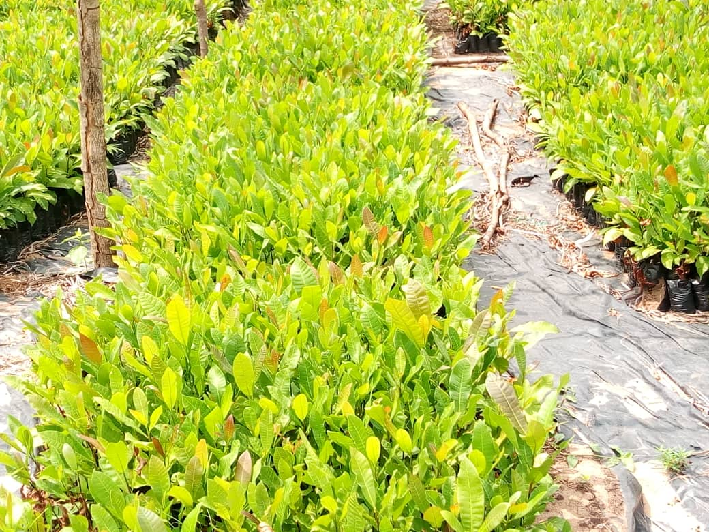
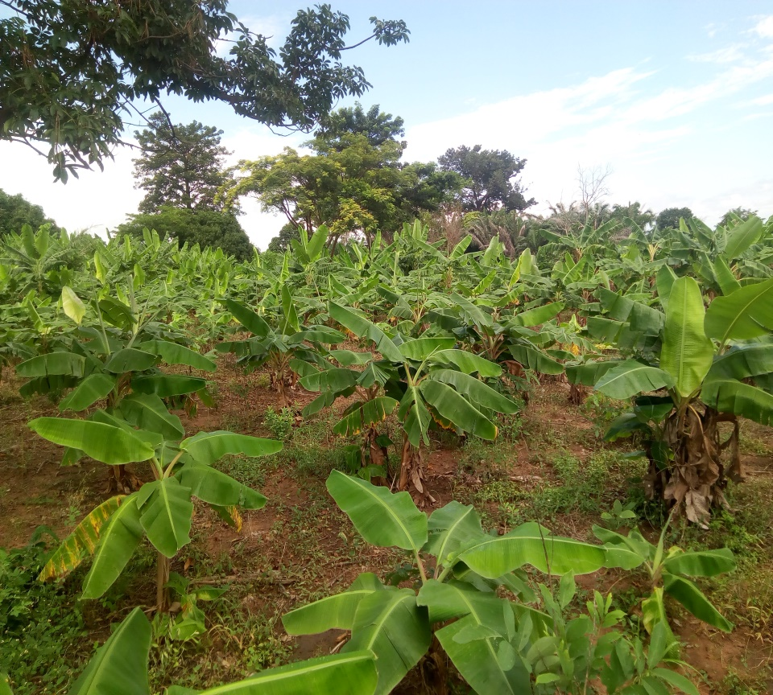

Slide 20
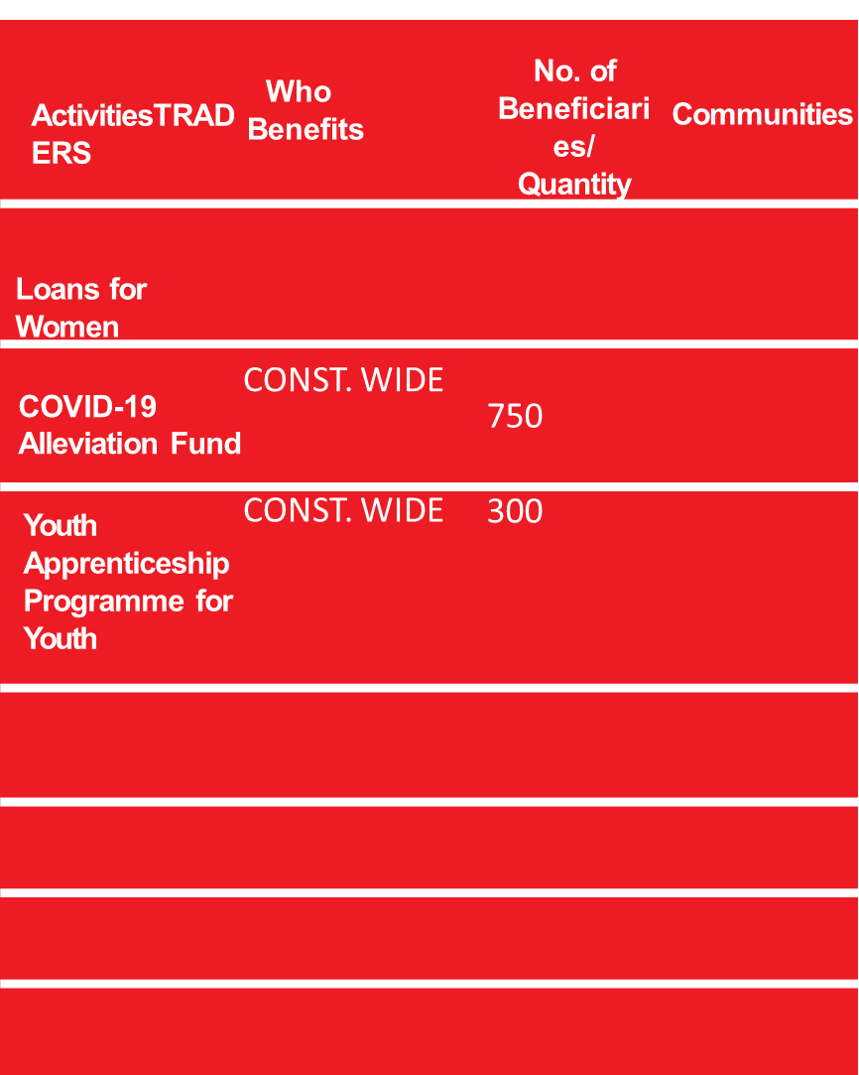
TRADE AND
INDUSTRY
NEW PATRIOTIC PARTY (NPP) • 2020 MANIFESTO

Slide 21
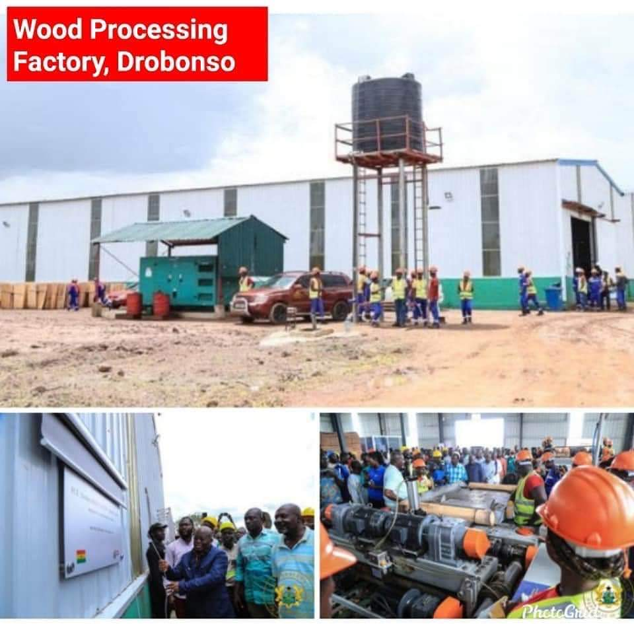
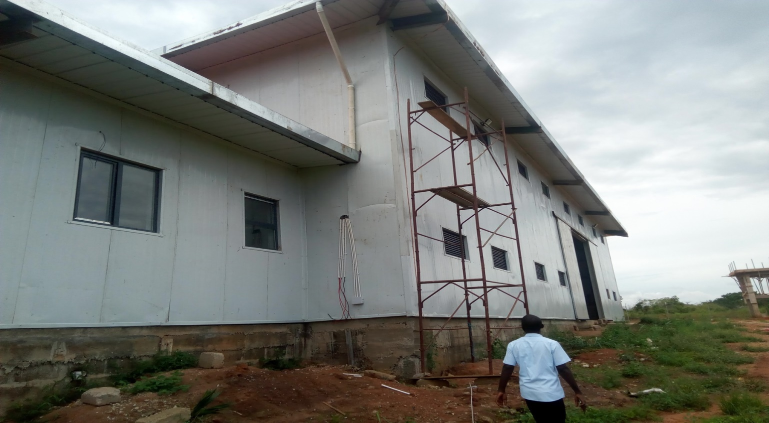
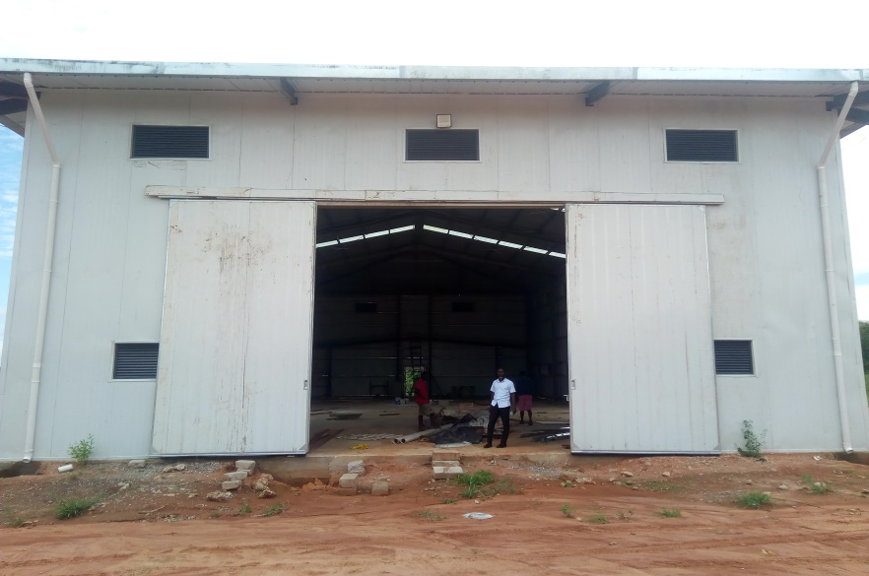
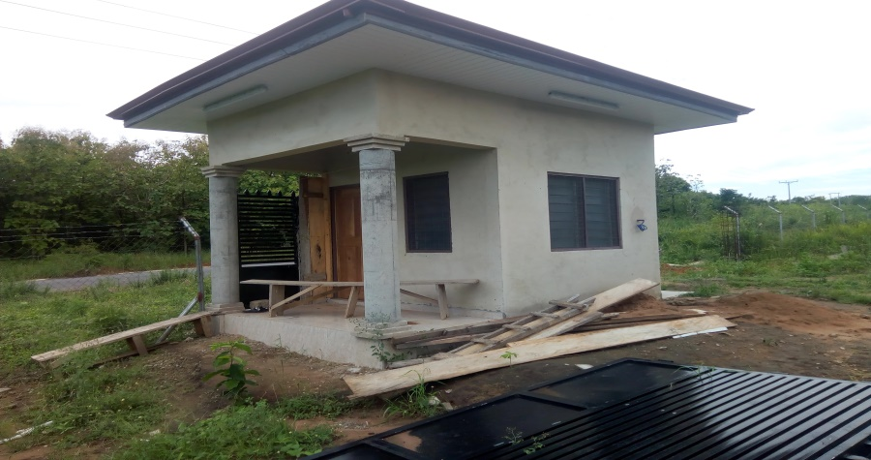
1 WAREHOUSE AT MAMPRUSI JUNCT. (90%) COMPLETE (AU-00107-1747)
SECURITY CHECK POST
22

Slide 22
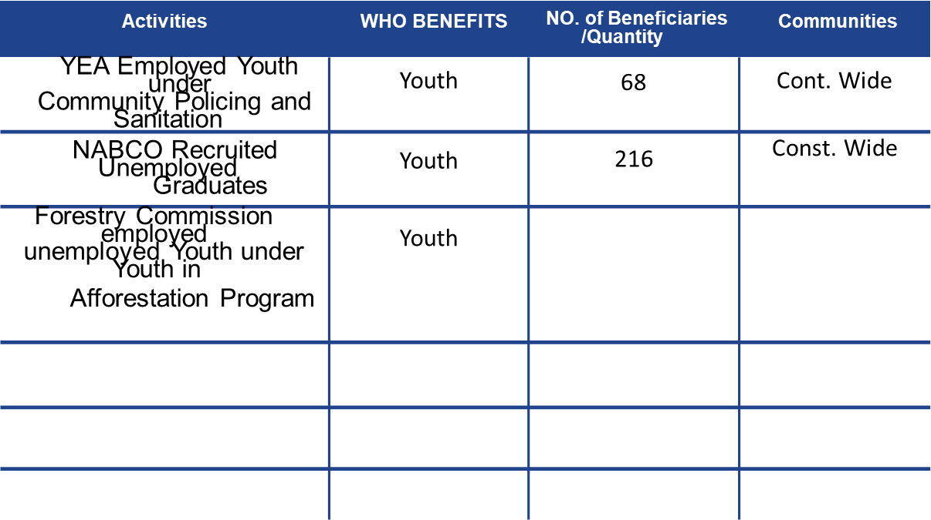
Social Development
NEW PATRIOTIC PARTY (NPP) • 2020 MANIFESTO

Slide 23
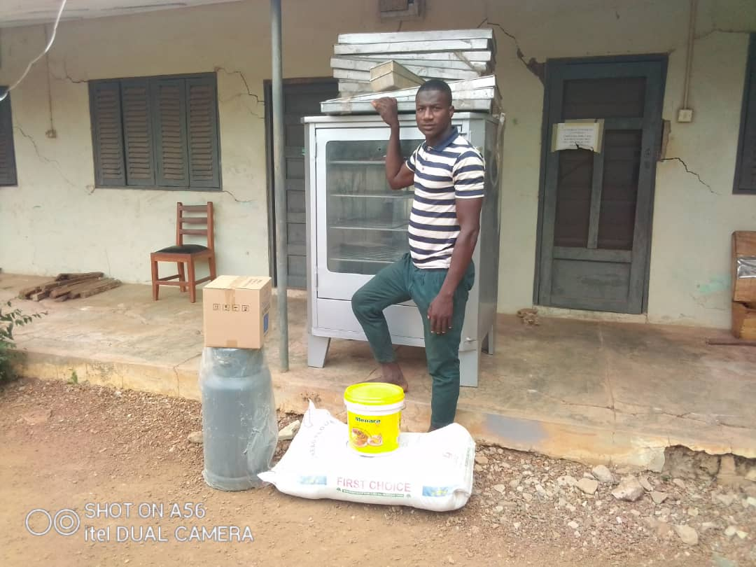
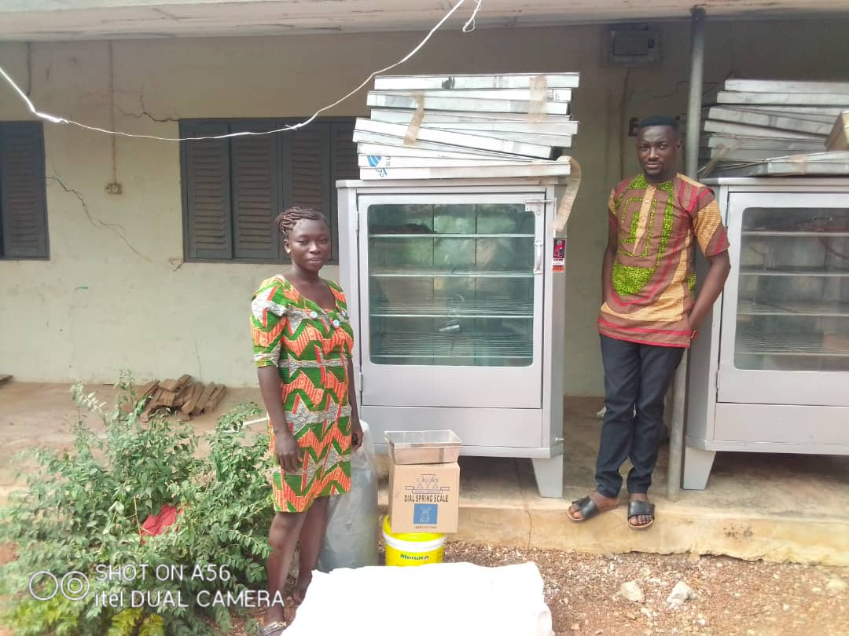
NEW PATRIOTIC PARTY (NPP) • 2020 MANIFESTO
24

Slide 24
Education
PROJECT | WHO BNENEFITY | NO. OF BENEFICIARIES | COMMUNITY
CONSTRUCTION OF BOYS DORMETOTRY | STUDENTS | CONST. WIDE | DROBONSO
CONSTRUCTION OF GIRLS DORMETORY | STUDENTS | CONST. WIDE | DROBONSO
CONSTRUCTION OF BOYS AND GIRLS TOIULET FACITIES | STUDENTS | CONST. WIDE | DROBONSO
6 UNIT CLASSROM BLK. SDA JHS | STUDENTS | COMMUNITY | ANYINOFI
6 UNIT CLASSROOM BLK. R/C PRIM. | STUDENTS | COMMUNITY | DROBONSO
3 UNIT CLASSROOM BLK. D/A PRIM. | STUDENTS | COMMUNITY | OFE
3 UNIT CLASSROOM BLK. D/A PRIM. 3 UNIT CLASSROOM BLK. D/A PRIM. | STUDENTS STUDENTS | COMMUNITY COMMUNITY | NYAMEBEKYERE BABADUASO
Activities
WHO BENEFITS
/QUANTITY
COMMUNITIES
NEW PATRIOTIC PARTY (NPP) • 2020 MANIFESTO

Slide 25
FREE SHS
ACTIVITY | WHO BENEFIT | NO. BENEFICIARIES
2017 | STUDENTS | 196
2018 2019 2020 | STUDENTS STUDENTS STUDENTS | 253 281 351
Notes:
7-2018

Slide 26
ONE MILLION DOLLAR ONE CONSTITUENCY
ACTIVITIES | BENEFICIARY COMMUNITY | WHO BENEFITS (IND, GROUPS, INSTITUTION)
CONSTRUCTION OF 3 UNIT CLASS ROOM | COMMUNITY | KONFININI AKOMA KUBU NYAME BEKYERE MEMPEKASA
CONSTRUCTION OF COORDINATING DIRECTORS/ DISTRICT MAGISTRATE QUARTERS | DIST. WIDE | DROBONSO
10 KM ROAD CONSTRUCTION 10 KM ROAD CONSTRUCTION | CONST. WIDE | DROBONSO-JEDUAKO BIREM-ANYINOFI
CONSTRUCTION OF CLINIC WITH NURSES AND DOCTORS QUARTERS | COMMUNITY | FUMSUA
CONSTRUCTION OF 10 SEATER W/C MECHANISED TOILET FACILITY, AT 6 LOCATIONS | COMMUNITY | DROBONSO ANYINOFI DAGOMBA FUMSUA HAMIDU SAMSO
CONSTRUCTION OF 3 BED ROOM TEACHERS QUARTERS AT 5 LOCATIONS | VARIOUS COMMUNITIES VARIOUS COMMUNITIES | CONST. WIDE CONST. WIDE
NEW PATRIOTIC PARTY (NPP) • 2020 MANIFESTO

Slide 27
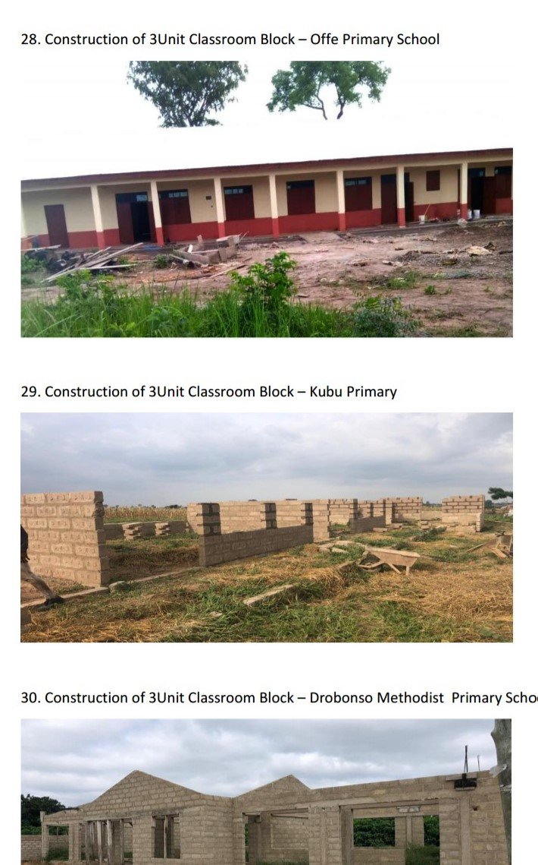
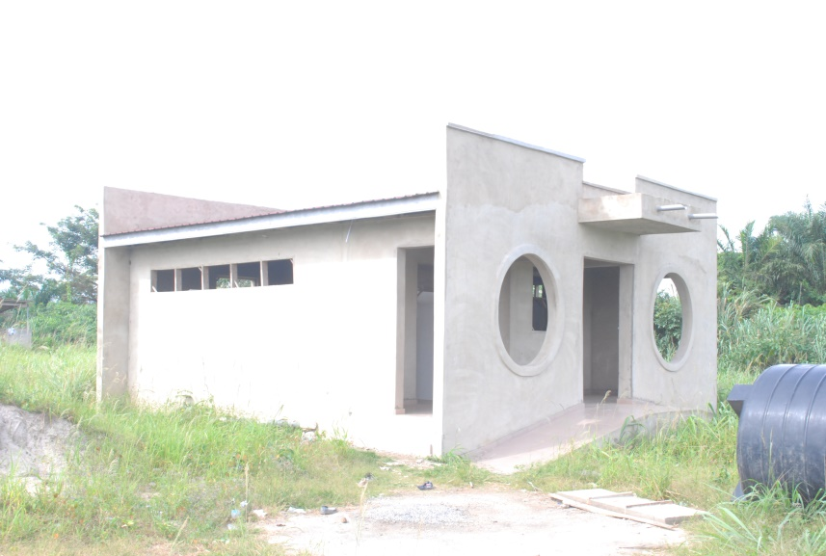
(PICTURES FOR EDUCATION HERE)
NEW PATRIOTIC PARTY (NPP) • 2020 MANIFESTO
28

Slide 29
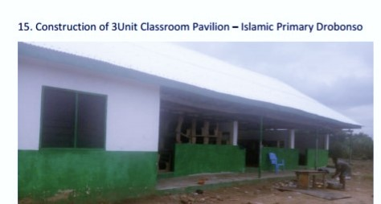

Slide 30
Health
ACTIVITIES |  |  | WHO BENEFITS | NO. OF BENEFICIARIES | COMMUNITY
 |  |  |  | /Quantity
1 | One Fully Kitted Ambulance and Ambulance Bay |  | Constituency, Unemployed Youth | CONSTITUENCY WIDE | Constituency Wide
2 | NHIA Card widely used |  | Constituency, Families | 22,000 | Constituency Wide
COVID-19 Support (provision of PPEs) |  |  | Health Facilities and Communities | ALL COMMUNITIES | Constituency Wide
4

Slide 31
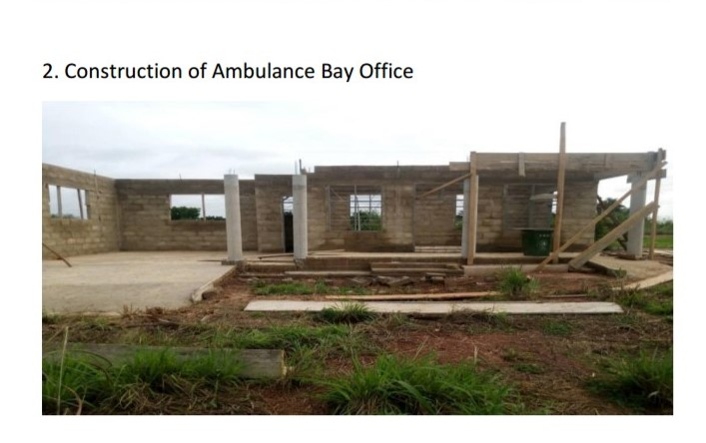

Slide 32
Beyond 2020
....What We will do

Slide 33
ACTIVITY | WHO BENEFIT | COMMUNITY
COMPLETION OF 6 UNIT CLASSROOMBLCK AT SDA PRIM. | COMMUNITY | ANYINOFI
COMPLETION OF 6 UNIT CLASSROOM BLK. AT DROBONSO R/C . PRIM | COMMUNITY | DROBONSO
COMPLETION OF 6 UNIT CLASSROOM BLK. AT DROBONSO SDA PRIM. | COMMUNITY | DROBONSO
COMPLETION OF 6 UNIT CLASSROOM BLK. AT MEMPEKASE D/A | COMMUNITY | MEMPEKASA
COMPLETION OF ALL ON-GHOING PROJECTS ACROSS | ALL COMMUNITIES | CONST. WIDE
CONSTRUCTION OF DISTRICT HOSPITAL(LAND CLEARED SO FAR) | CONST. WIDE | DROBONSO
DRIILING OF MORE BOREHOLES FOR VARIOUS COMMUNITIES | HOUSE HOLDS | CONST. WIDE
CONSTRUCTION OF FOOTBALL PITHES ACROSS FOR SPORTS DEVELOPMENT | YOUTH AND SCHOOLS | CONST. WIDE
ORGANIZING OF TARININGS FOR FARMERS ON NEW SYSTEM OF FARMING COMPLETION OF NEW ASSEMBLY BUIDING CONSTRUCTION OF YOUTH CENTER AT 2 COMMUNITIES | FARMERS ASSEMBLY YOUTHS & COMMUNITY | CONST. WIDE DROBONSO DROBONSO AND ANYINOFI
NEW PATRIOTIC PARTY (NPP) • 2020 MANIFESTO

Slide 34
ROADS
ROAD ACTIVITY | BENEFICIARY COMMUNITIES | GROUPS &INSTITUTIONS
COMPLETION OF DROBONSO -MEMEPE KASA ROAD | DROBONSO MEMPE KASA | CONST. WIDE
COMPLETION OF JEDUAKO -DROBONSO | DEDUAKO | ALL
CONSTRUCTION OF ANYINOFI TOWN ROADS | ANYINOFI | ALL
CONSTRUCTION ATEBUBU-ANYINOFI-MOSIPANYIN ROAD | ANYINOFI | ALL
CONSTRUCTION OF BONSOMFO –AKOMA-FUMSUA-OFFE ROAD | FUMSUA BOSOMFO | ALL
CONSTRUCTION OF BIREM TO ANYINOFI ROADS | DROBONSO | ALL
CONSTRUCTION OF DAWIA-KUBU-ANOKYE BEEMU-ABOTANTRI ROAD | DAWIA-ABOTANTRI | ALL
WATER AND SANITAION
MECHANAZATION OF ALL DRILLED BOREHOLES | ALL COMMUNITIES | CONSTIUENCY WIDE
EXTEND DRILLING OF BOREHOLES IN OTHER VILLAGES | COMMUNITIES YET TO HAVE ONE | CONST. WIDE
TO INCREASE ZOOM LION WORKERS ACROSS | ALL COMMUNITIES | CONST. WIDE

Slide 35
Social Development
ACTIVITIES | BENEFICIARY COMMUNITY | WHO BENEFITS (IND, GROUPS, INSTITUTION)
CONSTRUTION OF SOCIAL CENTER | DROBONSO | ALL
INCREASE SCHOLARSHIPS TO ALL GOOD BUT NEEDY STUDENTS | CONST. WIDE | ALL
ORGAINIZING OF TRAINING SERMINARS FOR THE YOUTH | CONST. WIDE | ALL
SHARING OF EXERCISE BOOKS TO STUDENTS | CONST. WIDE | ALL
Youth & Jobs
ACTIVITIES | BENEFICIARY COMMUNITY | WHO BENEFITS (IND, GROUPS, INSTITUTION)
TO INCREASE YEA AND NABCO BENEFICIARIES | CONST, WIDE | ALL YOUTH AND UNEMPLOYED GRADUATES
TO INTRODUCE YOUTH IN AFFORESTATION NAND ENROLLED | CONST. WIDE | ALL YOUTHS

Slide 36
INSERT REGIONAL CHAIRMAN MESSAGE
REGIONAL CHAIRMAN
INSERT REGIONAL CHAIRMAN PICTURE
NEW PATRIOTIC PARTY (NPP) • 2020 MANIFESTO
36

Slide 37
NEW PATRIOTIC PARTY
DEVELOPMENT IN FREEDOM

