Slide 1
DEVELPOMENTAL PROJECTS
ADANSI NORTH DISTRICT

Slide 2
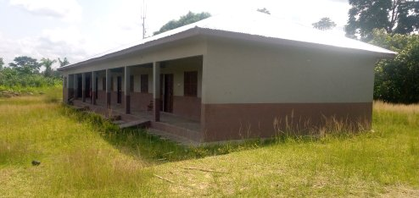
CONSTRUCTION OF 3 UNIT CLASSROOM BLOCK AT ASILIVIKROM(DACF)

Slide 3
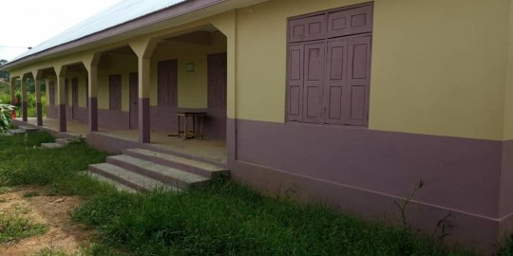
CONSTRUCTION OF 1NO 3 UNIT CLASSROOM BLOCK AT SARPONSO D/A JHS (DDF)

Slide 4
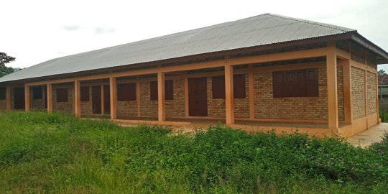
CONSTRUCTION OF 1NO 3 UNIT CLASSROOM BLOCK AT BODWESANGO SDA JHS (DACF)

Slide 5
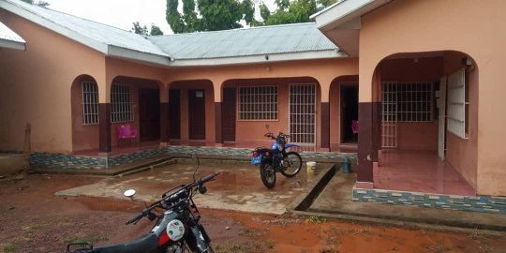
RENOVATION OF ASOKWA AREA COUNCIL TO BE USED AS ASSEMBLY HALL FOR ADANSI ASOKWA DISTRICT ASSEMBLY (DACF)

Slide 6
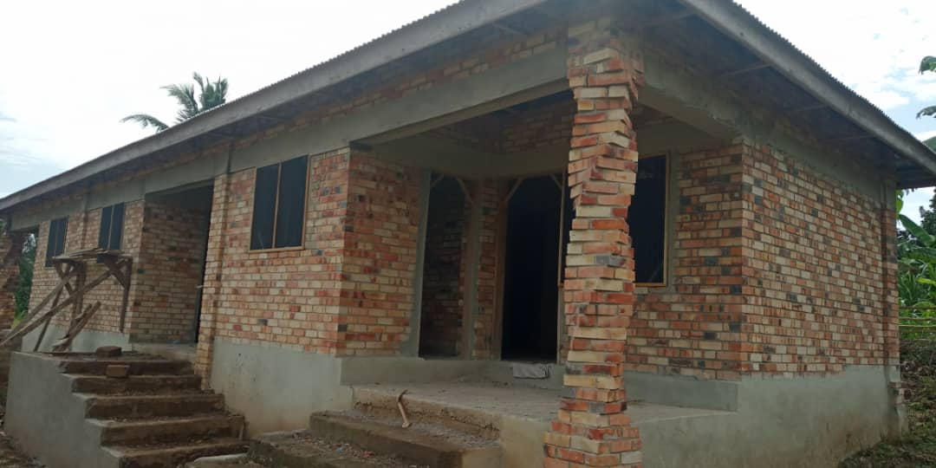
CONSTRUCTION OF 3 BEDROOM TEACHERS QUARTERS AT KUSA (DACF)

Slide 7
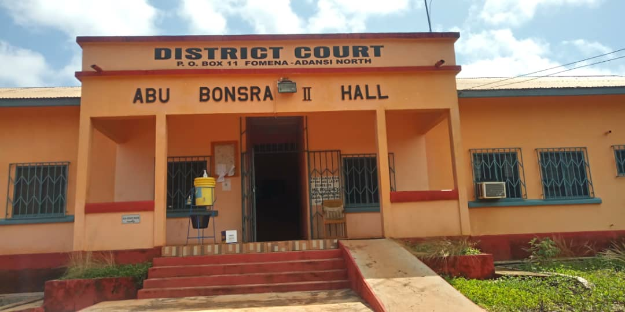
RENOVATION OF ABU BONSRA II HALL AS FOMENA DISTRICT COURT (DACF)

Slide 8
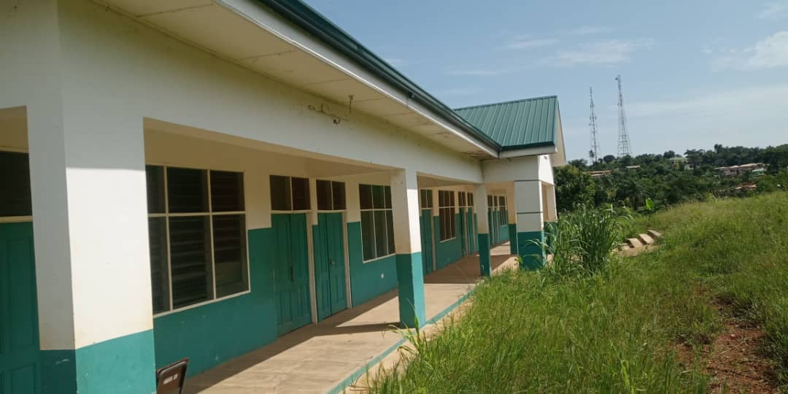
CONSTRUCTION OF 1NO 6 UNIT CLASSROOM BLOCK AT FOMENA AMASS (GETFUND)

Slide 9
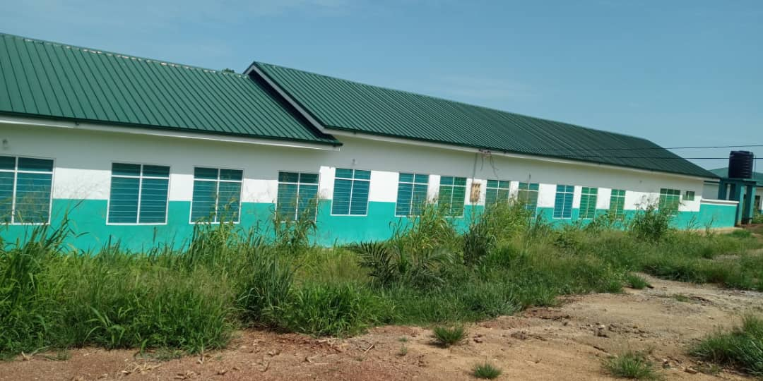
CONSTRUCTION OF 450 BED CAPACITY BOYS DORMITORY AT FOMENA AMASS (GETFUND)

Slide 10
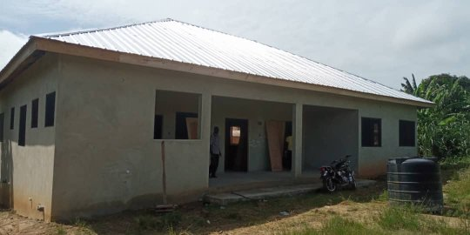
CONSTUCTION OF MODERN KITCHEN AT FOMENA NURSING TRAINING COLLEGE (DDF)

Slide 11
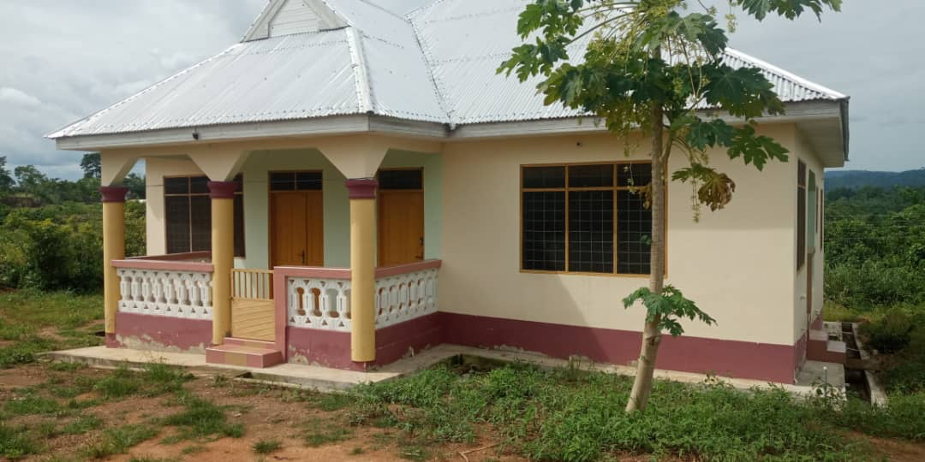
CONSTRUCTION OF AGRIC DIRECTOR’S BUNGALOW AT AYAASI NEW TOWN (DACF)

Slide 12
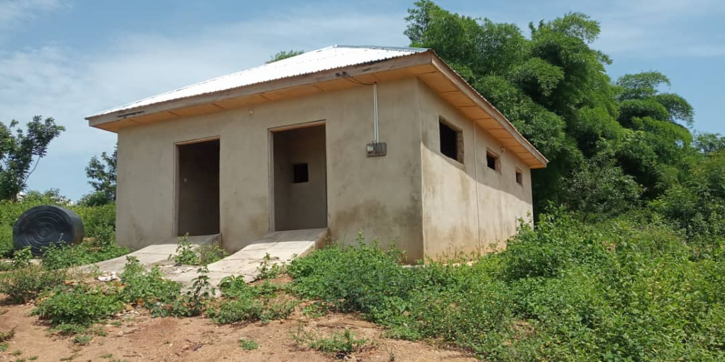
CONSTRUCTION ON 1NO 12 SEATER W/C WITH MECHANISED BOREHOLE AT AHINSAN (DDF)

Slide 13
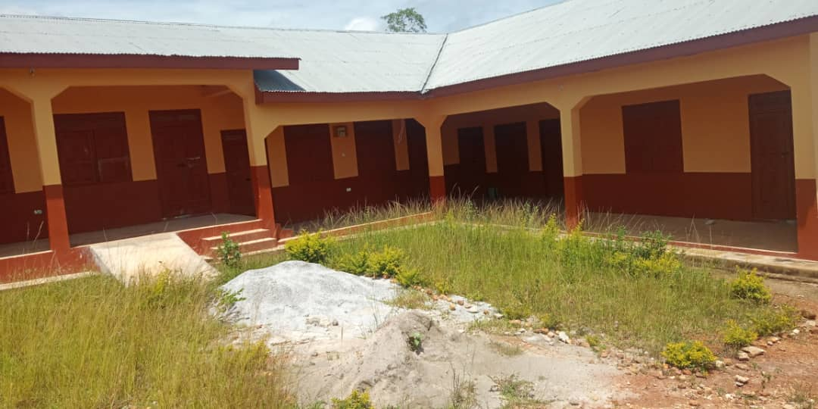
CONSTRUCTION OF 1NO 3 UNIT CLASSROOM BLOCK AT KYEABOSO D/A PRIMARY SCHOOL (DDF)

Slide 14
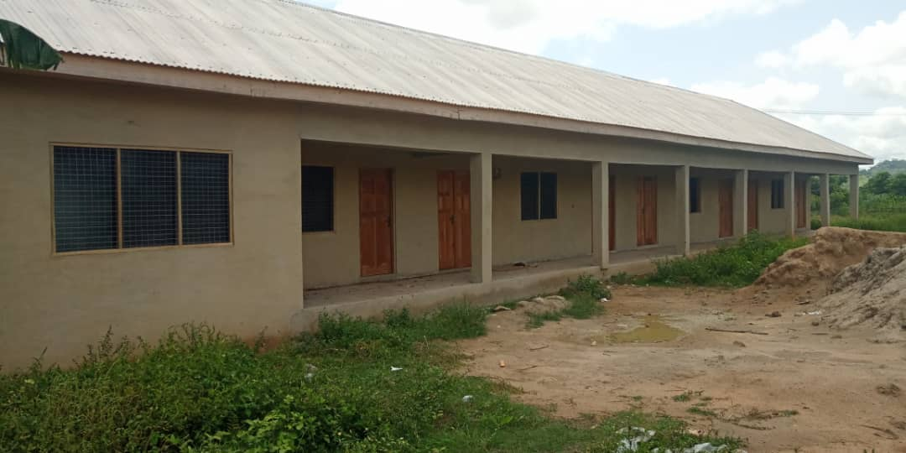
CONSTRUCTION OF 1NO 3 UNIT CLASSROOM BLOCK AT BOBRIASE D/A PRIMARY SCHOOL (DDF)

Slide 15
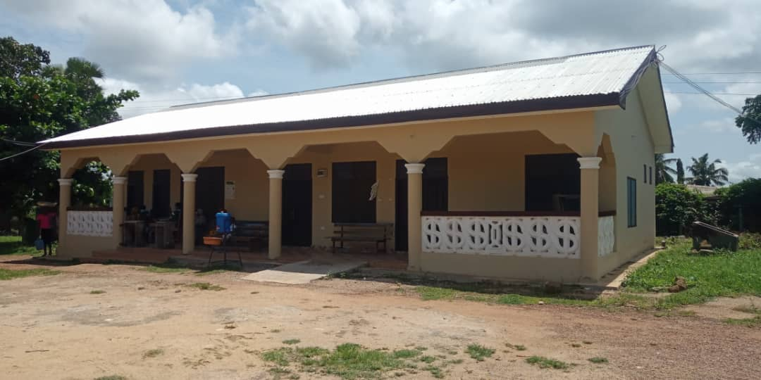
CONVERSION OF OLD GARAGE INTO MALE AND FEMALE WARD AT AKROKERRI HEALTH CENTER (DDF)

Slide 16
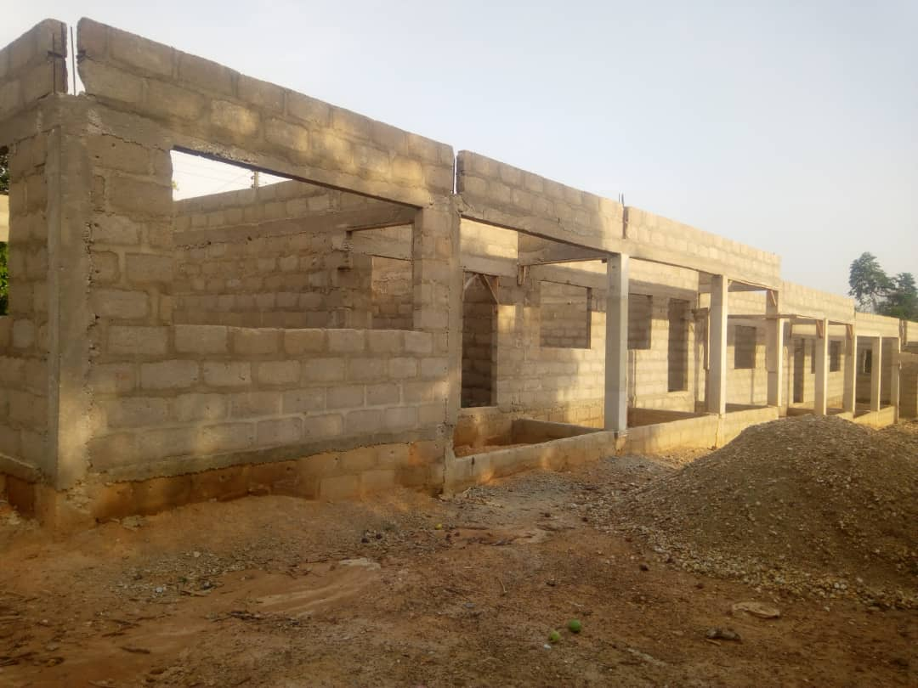
CONSTRUCTION OF 3 UNIT CLASSROOM BLOCK AT ADOKWAI D/A PRIMARY SCHOOL (DACF)

Slide 17
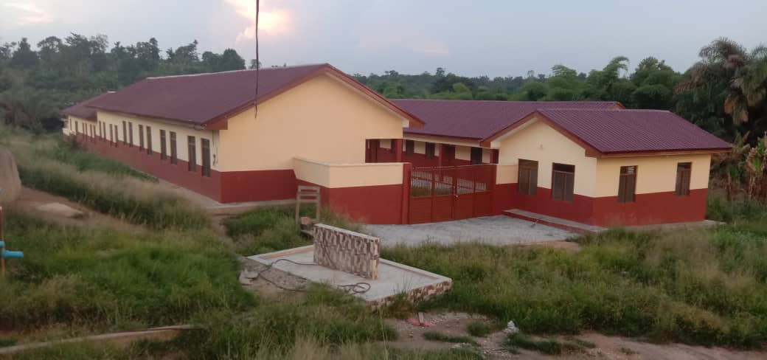
CONSTRUCTION OF 450 BED CAPACITY BOYS DORMITORY AT ASARE BEDIAKO SHS (GETFUND)

Slide 18
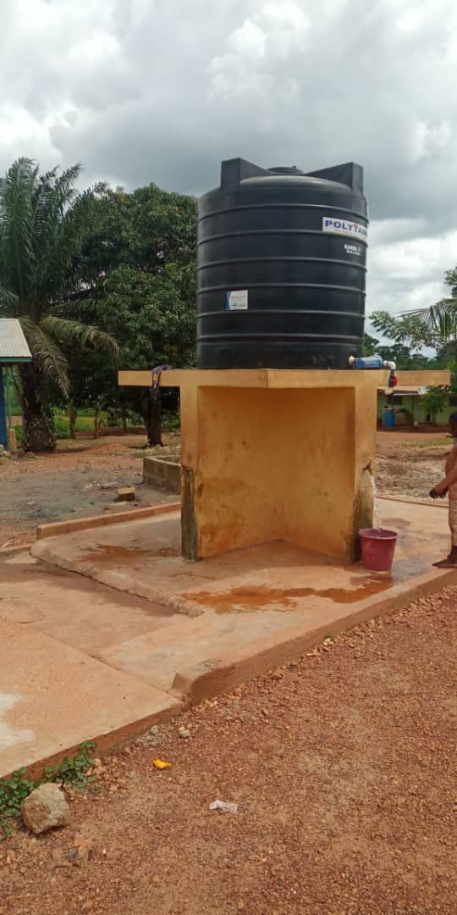
CONSTRUCTION OF MECHANISED BOREHOLE WITH OVER HEAD TANK AT ADOMANU (DDF)

Slide 19
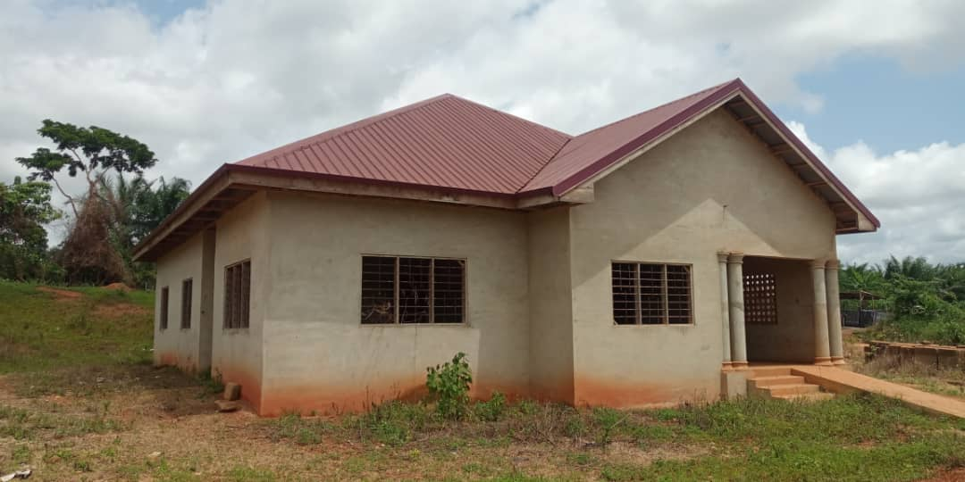
CONSTRUCTION OF CHPS COMPOUND AT DADWENE/KYEKYEWERE (DACF)

Slide 20
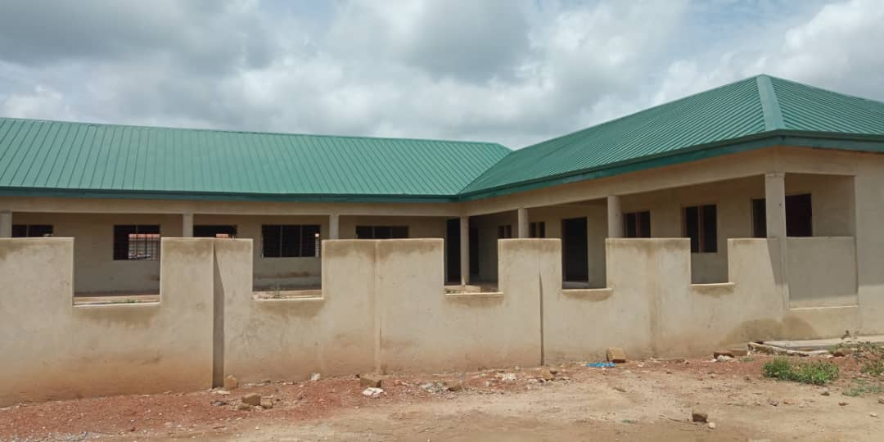
CONSTRUCTION 6 UNIT CLASSROOM BLOCK AT KYEKYEWERE D/A PRIMARY SCHOOL (GETFUND)

Slide 21
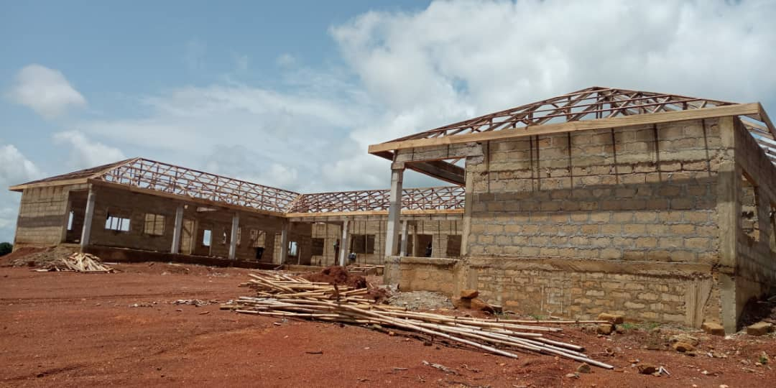
CONSTRUCTION 6 UNIT CLASSROOM BLOCK AT WIOSO D/A PRIMARY SCHOOL. (GETFUND)

Slide 22
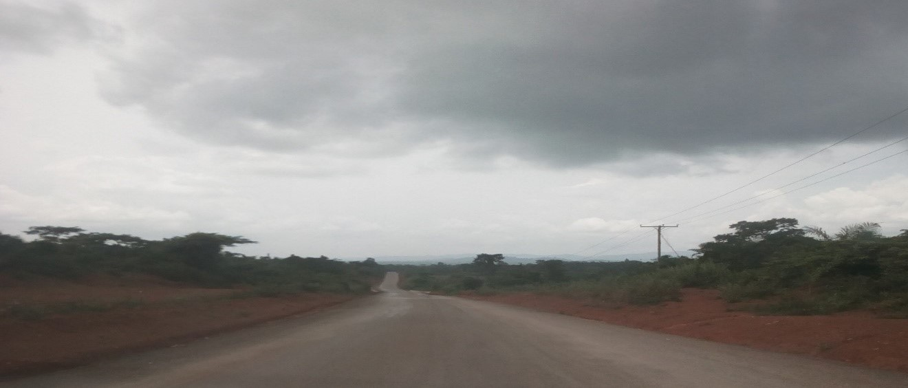
ROAD CONSTRUCTION OF 5.4 KM FROM KYEABOSO TO AKROKERRI (FEEDER ROADS)

